Slide 1
Computer Vision Project
Mohammad Sakka

Slide 2
IMAGING AND FUSING TIME SERIES FOR WEARABLE SENSORBASED HUMAN ACTIVITY RECOGNITION
the project aims to solve the wearable sensors fusion problem for recognizing the human activity using an innovative method by leveraging the computer vision techniques by converting the sensors data to images then using the deep learning techniques to get high accuracy activity recognition model.

Slide 3
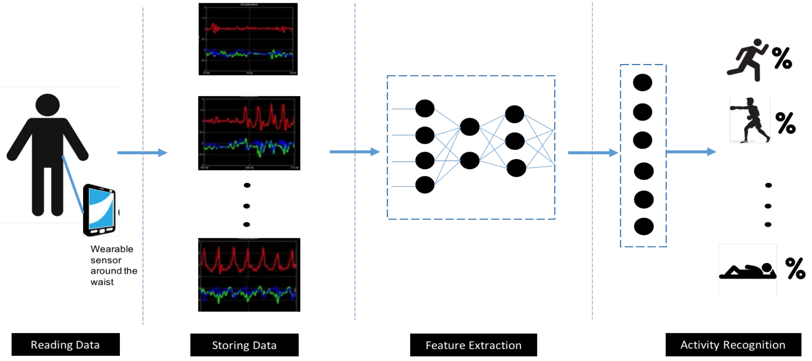
General Concept

Slide 4
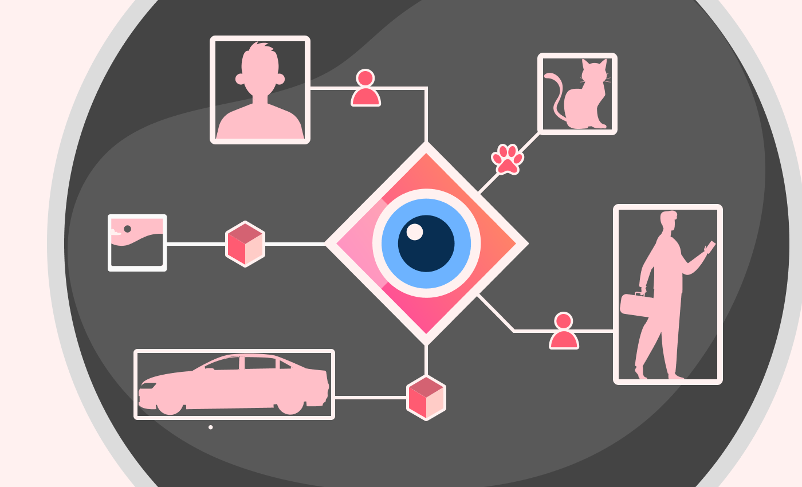
Leveraging Computer vision Techniques

Slide 5
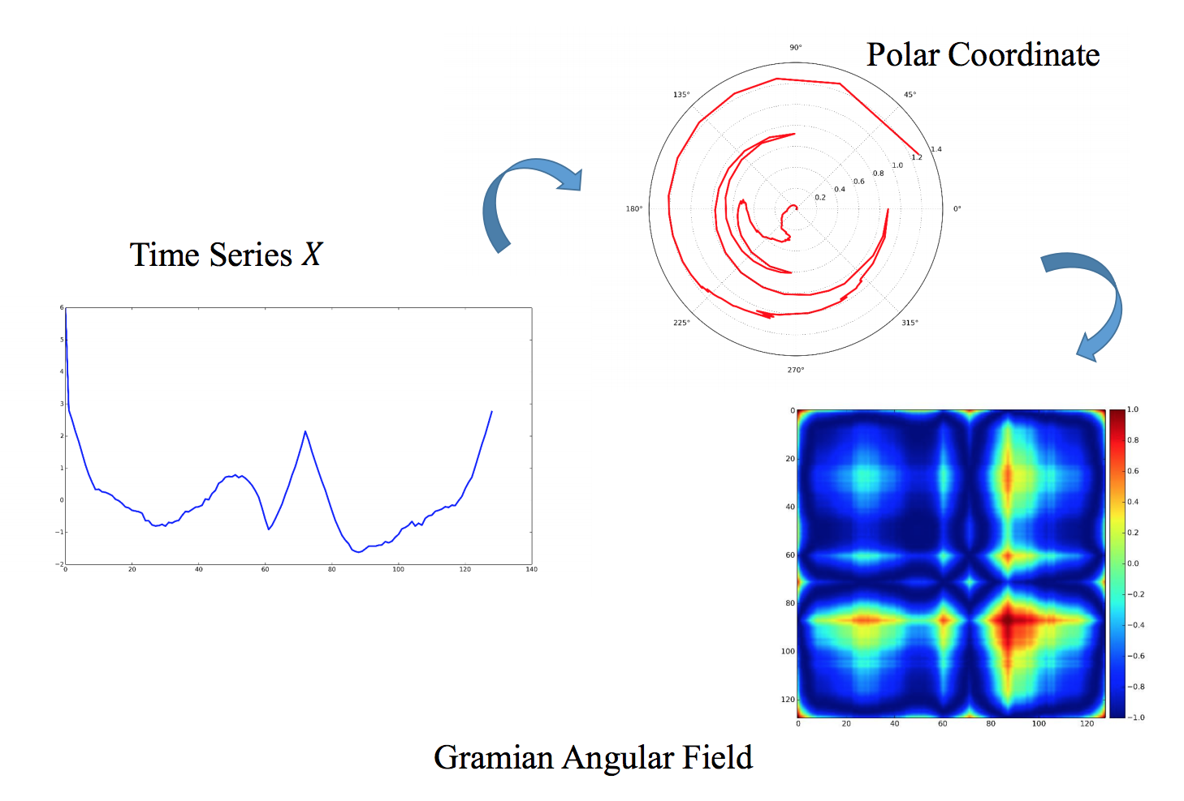
Time Series Imaging and Gramian Angular Fields

Slide 6
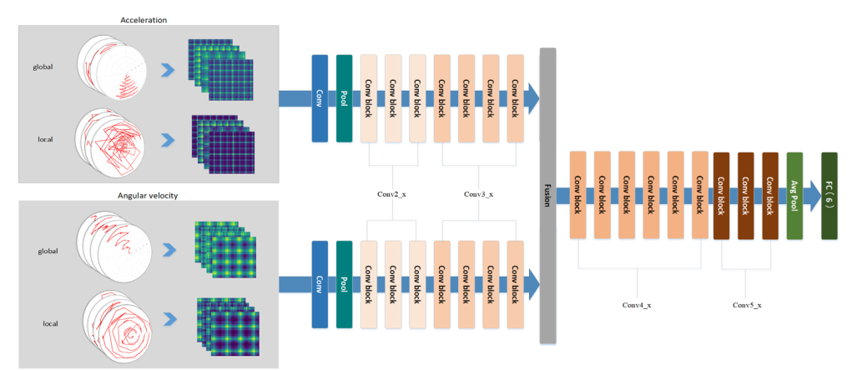
Methodology

Slide 7
Simplified Methodology Due to lack of time ):
Data from only one sensor (Ankle acceleration sensor)
CNN Feature extractor
NN classifier
Predicted Activity

Slide 8
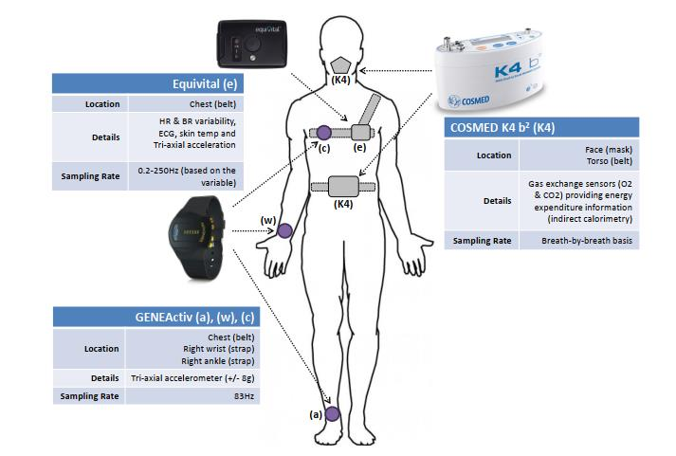
Dataset
GOTOV https://data.4tu.nl/articles/dataset/GOTOV_Human_Physical_Activity_and_Energy_Expenditure_Da taset_on_Older_Individuals/12716081

Slide 9
Implementation with Python
Reading the timeseries measurements for each participant individually and normalize it
Concatenating all timeseries from all user vertically
Dividing the last full timesries to equivelant windows, each window should be for one participant and one label, no participant or label overlapping in one window
Converting each window to image using GAF, and link it with each activity label
Passing the resulted images dataset to a CNN and training the model

Slide 10
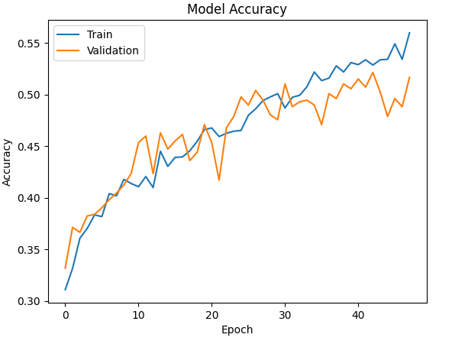
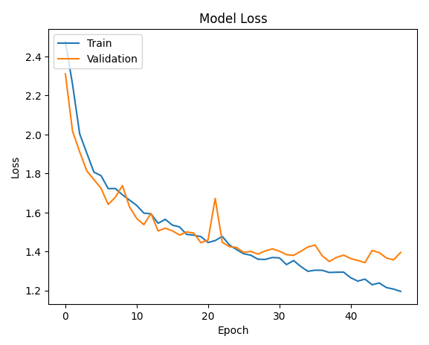
Results

Slide 11
Results Discussion
Unfortunately, The accuracy is very low due to lack of the time and the simplified methodology

Slide 12


